Slide 1
Unit 1

Slide 2
Syllabus
Introduction and Basics of Algorithm, Algorithm specification
Example of an algorithm, Performance Analysis : Space and Time Complexity, Characteristics of an algorithm, Correctness of Algorithms,
Growth of function, examples, Asymptotic Notations and Types, Concept of Randomized Algorithms.
Substitution Method, Iteration Method, Master Method, Recurrence Tree method.

Slide 3
Correctness of Algorithm – Concept and Proof
The well-defined computational problem is a triplet of P (I, O, R) such that I is the valid input set, O is the accepted output set, and R defines the relationship between I and O. R can be considered as a mapping function, which translates I to O.
Let i ∈ I is a problem instance. The algorithm to solve problem P is correct if and only if for all the problem instance i ∈ I, it terminates and produces correct output o ∈ O, i.e. (i, o) ∈ R.

Slide 4
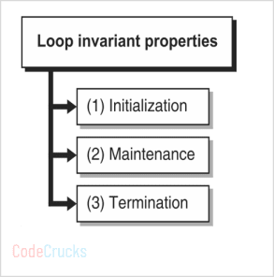
Algorithms for real-life problems often involve a loop. The correctness of such an algorithm is proved through the loop invariant property. It involves three steps:
Initialization: Conditions true before the first iteration of the loop
Maintenance: If the condition is true before the loop, it must be true before the next iteration.
Termination: On termination of the loop, the invariant gives us a useful property that helps us prove the correctness of the algorithm.

Slide 5
Example:
Algorithm INSERTION_SORT(A, n)
for j ← 2 to n do
Key ← A[j]
i ← j – 1
while i > 0 && key < A[i] do
A[i + 1] ← A[i]
i ← i – 1
end
A[i + 1] ← key
end

Slide 6
Let us try to prove the correctness of INSERTION_SORT using three-loop invariant properties.
Initialization: The loop invariant holds before initialization. For j = 2, subarray A[1…j – 1] contains only one element, i.e. A[1]. This is a trivial case of sorting. It proves that the loop invariant is true before the first iteration.
Maintenance: In each iteration, the algorithm finds the correct position of the key to insert the element A[j] by moving A[j – 1], A[j – 2],.. elements. After the loop, A[j] element will be inserted into the correct position. After the loop, A[1…j] contains elements the same as in A[1…j] before the loop, but now they will be in sorted order. Thus the invariant is held in attendance too.
Termination: The loop terminates when j = n. Each iteration inserts A[j] on the correct location, so after n iteration, all elements will be in their right position. After the loop, A[1…n] contains elements the same as in A[1…n] before the loop, but now they will be in sorted order.

Slide 7
What is algorithm
An algorithm is a process or a set of rules required to perform calculations or some other problem-solving operations especially by a computer.
The formal definition of an algorithm is that it contains the finite set of instructions which are being carried in a specific order to perform the specific task. It is not the complete program or code; it is just a solution (logic) of a problem, which can be represented either as an informal description using a Flowchart or Pseudocode.

Slide 8
Characteristics of an Algorithm
The following are the characteristics of an algorithm:
Input: An algorithm has some input values. We can pass 0 or some input value to an algorithm.
Output: We will get 1 or more output at the end of an algorithm.
Unambiguity: An algorithm should be unambiguous which means that the instructions in an algorithm should be clear and simple.
Finiteness: An algorithm should have finiteness. Here, finiteness means that the algorithm should contain a limited number of instructions, i.e., the instructions should be countable.
Effectiveness: An algorithm should be effective as each instruction in an algorithm affects the overall process.
Language independent: An algorithm must be language-independent so that the instructions in an algorithm can be implemented in any of the languages with the same output.

Slide 9
Approaches of Algorithm
The following are the approaches used after considering both the theoretical and practical importance of designing an algorithm:
Brute force algorithm: The general logic structure is applied to design an algorithm. It is also known as an exhaustive search algorithm that searches all the possibilities to provide the required solution. Such algorithms are of two types:
Optimizing: Finding all the solutions of a problem and then take out the best solution or if the value of the best solution is known then it will terminate if the best solution is known.
Sacrificing: As soon as the best solution is found, then it will stop.
Divide and conquer: It is a very implementation of an algorithm. It allows you to design an algorithm in a step-by-step variation. It breaks down the algorithm to solve the problem in different methods. It allows you to break down the problem into different methods, and valid output is produced for the valid input. This valid output is passed to some other function.

Slide 10
Greedy algorithm: It is an algorithm paradigm that makes an optimal choice on each iteration with the hope of getting the best solution. It is easy to implement and has a faster execution time. But, there are very rare cases in which it provides the optimal solution.
Dynamic programming: It makes the algorithm more efficient by storing the intermediate results. It follows following steps to find the optimal solution for the problem:
It breaks down the problem into a subproblem to find the optimal solution.
After breaking down the problem, it finds the optimal solution out of these subproblems.
Stores the result of the subproblems is known as memorization.
Reuse the result so that it cannot be recomputed for the same subproblems.
Finally, it computes the result of the complex program.
Branch and Bound Algorithm: The branch and bound algorithm can be applied to only integer programming problems. This approach divides all the sets of feasible solutions into smaller subsets. These subsets are further evaluated to find the best solution.

Slide 11
Randomized Algorithm: In a randomized algorithm, some random bits are introduced by the algorithm and added in the input to produce the output, which is random in nature. Randomized algorithms are simpler and efficient than the deterministic algorithm.
Backtracking: Backtracking is an algorithmic technique that solves the problem recursively and removes the solution if it does not satisfy the constraints of a problem.

Slide 12
Algorithm Complexity
The performance of the algorithm can be measured in two factors:
Time complexity: The time complexity of an algorithm is the amount of time required to complete the execution. The time complexity of an algorithm is denoted by the big O notation. Here, big O notation is the asymptotic notation to represent the time complexity. The time complexity is mainly calculated by counting the number of steps to finish the execution.
Space complexity: An algorithm's space complexity is the amount of space required to solve a problem and produce an output. Similar to the time complexity, space complexity is also expressed in big O notation.

Slide 13
Steps in Designing of Algorithms
Step – 1 : Obtain detailed information on the problem.
It is a very important step in writing an algorithm. Before starting with an algorithm the programmer must obtain maximum information about the problem that needs to be solved.
Step – 2 : Analyze the problem.
Proper Analysis of the problem must be done including the data that must be gained, processed and retrieved for generating a valid output.
Step – 3 : Think of a problem solving approach.
The programmer has to come up with a problem solving approach that will help us to build the model to solve the given problem.

Slide 14
Step – 4 : Review the problem solving approach and try to think of a better Alternative.
A high quality Algorithm must contain the best approach to solve a problem which will help in reducing the effort in coding as well as decrease time complexity and size of the program.
Step – 5 : Develop a basic structure of the Algorithm.
Develop a basic structure of the problem solving approach; explain the approach step-by-step with short and effective description.
Step – 6 : Optimize, Improve and refine.
After developing an Algorithm try optimizing the explanation to increase readability and accessibility of it.

Slide 15
Asymptotic Analysis
In Asymptotic Analysis, we evaluate the performance of an algorithm in terms of input size.
We calculate, how the time (or space) taken by an algorithm increases with the input size.
The main idea of asymptotic analysis is to have a measure of the efficiency of algorithms that don’t depend on machine-specific constants and don’t require algorithms to be implemented and time taken by programs to be compared.
For example, let us consider the search problem (searching a given item) in a sorted array.
The solution to above search problem includes:
Linear Search (order of growth is linear)
Binary Search (order of growth is logarithmic).

Slide 16
Complexity of Algorithms
Algorithm complexity measures how many steps are required by the algorithm to solve the given problem. It evaluates the order of count of operations executed by an algorithm as a function of input data size.
O(f) notation represents the complexity of an algorithm, which is also termed as an Asymptotic notation or "Big O" notation. Here the f corresponds to the function whose size is the same as that of the input data.

Slide 17
Typical Complexities of an Algorithm
Constant Complexity: It imposes a complexity of O(1).
Logarithmic Complexity: It imposes a complexity of O(log(n)).
Linear Complexity: It imposes a complexity of O(n).
Linearithmic Complexity: It imposes a complexity of O(n*log(n)).
Quadratic Complexity: It imposes a complexity of O(n²).
Cubic Complexity: It imposes a complexity of O(n³).
Exponential Complexity: It imposes a complexity of O(2^{n}), O(N!), O(n^{k}), …. For n elements.

Slide 18
Growth of function
The order of growth of the running time of an algorithm gives a simple characterization of the algorithm's efficiency and also allows us to compare the relative performance of alternative algorithms.
Once the input size n becomes large enough, merge sort, with its (nlogn) worst-case running time, beats insertion sort, whose worst-case running time is (n²).
The growth rate for an algorithm is the rate at which the cost of the algorithm grows as the size of its input grows.

Slide 19
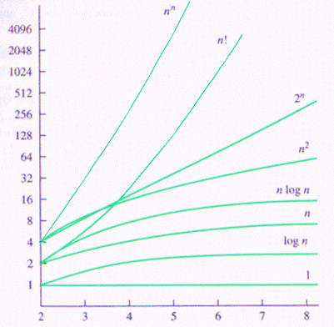

Slide 20
Question: Identify the increasing order of asymptotic complexity of functions f1, f2, f3 and f4?
f1(n) = 2^n
f2(n) = n^(3/2)
f3(n) = nlogn
f4(n) = n^(Logn)
Answer: f3, f2, f4, f1

Slide 21
Question: Identify the increasing order of asymptotic complexity of functions f1, f2, f3 and f4?
f1(n) = n + log n
f2(n) = n ^{1/3}
f3(n) = n ^{n}
f4(n) = n log n
Answer: f2, f1, f4, f3

Slide 22
Types of Asymptotic Notations
Asymptotic notations are mathematical tools to represent the time complexity of algorithms for asymptotic analysis.
There are mainly three asymptotic notations:
Big-O Notation (O-notation)
Omega Notation (Ω-notation)
Theta Notation (Θ-notation)

Slide 23
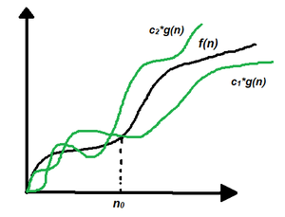
Theta Notation (Θ-notation)
Theta notation encloses the function from above and below. Since it represents the upper and the lower bound of the running time of an algorithm, it is used for analyzing the average-case complexity of an algorithm.
Let g and f be the function from the set of natural numbers to itself. The function f is said to be Θ(g), if there are constants c1, c2 > 0 and a natural number n0 such that c1* g(n) ≤ f(n) ≤ c2 * g(n) for all n ≥ n0
Θ (g(n)) = {f(n): there exist positive constants c1, c2 and n0 such that 0 ≤ c1*g(n) ≤ f(n) ≤ c2*g(n) for all n ≥ n0}

Slide 24
Big-O Notation (O-notation)
Big-O notation represents the upper bound of the running time of an algorithm. Therefore, it gives the worst-case complexity of an algorithm.
If f(n) describes the running time of an algorithm, f(n) is O(g(n)) if there exist a positive constant C and n0 such that, 0 ≤ f(n) ≤ cg(n) for all n ≥ n0
O(g(n)) = { f(n): there exist positive constants c and n0 such that 0 ≤ f(n) ≤ cg(n) for all n ≥ n0 }

Slide 25
Omega Notation (Ω-notation)
Omega notation represents the lower bound of the running time of an algorithm. Thus, it provides the best case complexity of an algorithm.
Let g and f be the function from the set of natural numbers to itself. The function f is said to be Ω(g), if there is a constant c > 0 and a natural number n0 such that c*g(n) ≤ f(n) for all n ≥ n0
Ω(g(n)) = { f(n): there exist positive constants c and n0 such that 0 ≤ cg(n) ≤ f(n) for all n ≥ n0 }

Slide 26
Recurrence relation
There are two types of algorithms to solve the problem:
Iterative Algorithm: In the iterative approach, the function repeatedly runs until the condition is met or it fails. It involves the looping construct.
Recursive Algorithm: In the recursive approach, the function calls itself until the condition is met. It integrates the branching structure.
A recurrence is an equation or inequality that reflects the value of a function with smaller inputs. A recurrence can be used to represent the running duration of an algorithm that comprises a recursive call to itself.

Slide 27
Example: Consider the following code:
int recursiveFun1(int n)
{
if (n <= 0)
return 1;
else
return 1 + recursiveFun1(n-1);
}
Write the recurrence equation for the above code.
Solution: T(n) = T(n-1) + 3

Slide 28
Example: Consider the following code:
Fib(a)
{
if(a==1 || a==0)
return 1;
return Fib(a-1) + Fib(a-2);
}
Write the recurrence equation for the above code.
Solution: T(n) = T(n-1) + T(n-2) + 6

Slide 29
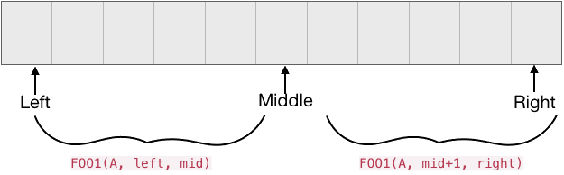
Example: Consider the following code:
FOO(A, low, high, x)
if (low > high)
return False
mid = floor((high+low)/2)
if (x == A[mid])
return True
if (x < A[mid])
return FOO(A, low, mid-1, x)
if (x > A[mid])
return FOO(A, mid+1, high, x)
Write the recurrence equation for the above code.
Solution: T(n) = T(n/2) + O(1)

Slide 30
How to solve Recurrence relation
There are three methods for solving Recurrence:
Substitution Method
Iteration Method
Master Method

Slide 31
Substitution Method
The Substitution Method Consists of two main steps:
Guess the Solution.
Use the mathematical induction to find the boundary condition and shows that the guess is correct.

Slide 32
Example 1: Solve the equation by Substitution Method.
T (n) = T(n/2) + 1
Solution: Assume O(log n) is the solution of the problem.
Put (T(n)=log n) in the recurrence:
T(n) = (log (n/2))+ 1
= log n – log 2 + 1
= log n ( log 2 =1)
<= c log n for any c >=1
Thus the complexity of the recurrence is O(log n).

Slide 33
Example 2: Solve the equation by Substitution Method.
T (n) = T(n-1) + 1
Solution: Assume O(n) is the solution of the problem.
Put (T(n)=n) in the recurrence:
T(n) = n - 1+ 1
= n
<= c n for any c >=1
Thus the complexity of the recurrence is O(n).

Slide 34
Example 3: Solve the equation by Substitution Method.
T (n) = 2T(n/2) + n
Solution: We guess the solution is O (n log n) for the equation.
Put (T(n) = n logn ) in the recurrence:
T (n) = 2 (n/2) log (n/2) + n
T (n) = n log (n/2) + n
T (n) = n log n - n log 2 + n
T (n) = n log n – n + n
T (n) = n log n
≤ c * n log n for any c > 0
Thus the complexity of the recurrence is O(n log n).

Slide 35
Iteration Method
It means to expand the recurrence and express it as a summation of terms of n and initial condition.
Example1: Solve the equation by iteration Method
T (n) = 2T (n-1) if n>1
Where T(1) = 1

Slide 36
T (n) = 2T (n-1)
= 2[2T (n-2)] = 2²T (n-2)
= 4[2T (n-3)] = 2³T (n-3)
= 8[2T (n-4)] = 2⁴T (n-4) (Eq.1)
Repeat the procedure for i times
T (n) = 2^{i} T (n-i)
Put n-i=1 or i= n-1 in (Eq.1)
T (n) = 2^{n-1} T (1)
= 2^{n-1} .1 {T (1) =1 .....given}
= 2^{n-1}
<= 2^{n}
Thus the complexity of the recurrence is O(2^{n}).

Slide 37
Example 2: Solve the equation by iteration Method.
T (n) = 2T(n/2) + n where T(1)=1
Solution:
T (n) = 2T(n/2) + n
T (n) = 2(2(T(n/4)+n/2))+ n = 2(2(T(n/4)))+n+ n
T (n) = 2(4(T(n/8)+n/4)+n+n
.
.
.
T(n) = 2^{i} T(n/ 2^{i} ) + n*i …… (Eq. 1)
We know that n/ 2^{i} = 1 i.e. n = 2^{i} and i = log n, So put the value of n in Eq. (1).
T(n) = n T(2^{i} / 2^{i} ) + n log n = n T(1) + n log n = n + n log n
Here the highest order term is n log n
Thus the complexity of the recurrence is O(n log n).

Slide 38
Example 3: Solve the equation by iteration Method.
T (n) = T(n-1) + n where T(0)=1
Solution:
T (n) = T(n-1) + n
T (n) = T(n -1-1) + n + (n-1) = T (n-2) + (n + (n-1))
T (n) = T(n-3) + (n+(n-1)+(n-2))
.
.
.
T(n) = T(n-i) + (n+(n-1)+(n-2)+…..+(n-i))
T(n) = T(n-i) + n*i - (1+2+3+4……. (i-1)) ….. (Eq. 1)
We know that n-i = 0 i.e. n = i and i = n -1, So put the value of n in Eq. (1).
T(n) = T(0) + n*n + (i-1)(i)/2 = 1 + n² + (n² – n)/2
Here the highest order term is n² .
Thus the complexity of the recurrence is O(n²).

Slide 39
Example 4: Solve the equation by iteration Method.
T (n) = 8T(n/2) + n² where T(1)=1
Solution:
T (n) = 8T(n/2) + n²
T (n) = 8(8(T(n/4)+(n/2)²))+ n² = 8(8(T(n/4))) + n² ( 1 + 2)
T (n) = 8(8(8(T(n/8)+(n²/8)) + n² ( 1 + 2) = 8(8(8(T(n/8)))) + n² ( 1 + 2 + 2²)
.
.
T(n) = 8^{i} T(n/ 8^{i} ) + n² (1 + 2 + 2² + …. 2^{i}) …… (Eq. 1)
As we know that (1 + 2 + 2² + …. 2^{i}) = (1* 2^{i} )/(2-1) = 2^{i}
We also know that n/ 8^{i} = 1 i.e. n = 8^{i} and i = log n, So put the value of n in Eq. (1).
T(n) = 8^{i} T(2^{i} / 2^{i} ) + n² * 2^{i} = n T(1) + n² * 2^{i}
= n + n² * 2^{logn}
= n + n² * n (because n < 2^{logn})
= n + n³
Here the highest order term is n³ .
Thus the complexity of the recurrence is O(n³).

Slide 40
Master Method
The master method is used for solving recurrence relations of the form:
T(n) = aT(n/b) + f(n)
where,
n = size of input
a = number of subproblems in the recursion
n/b = size of each subproblem. All sub problems are assumed to have the same size.
f(n) = cost of the work done outside the recursive call,
Here, a ≥ 1 and b > 1 are constants, and f(n) is an asymptotically positive function.

Slide 41
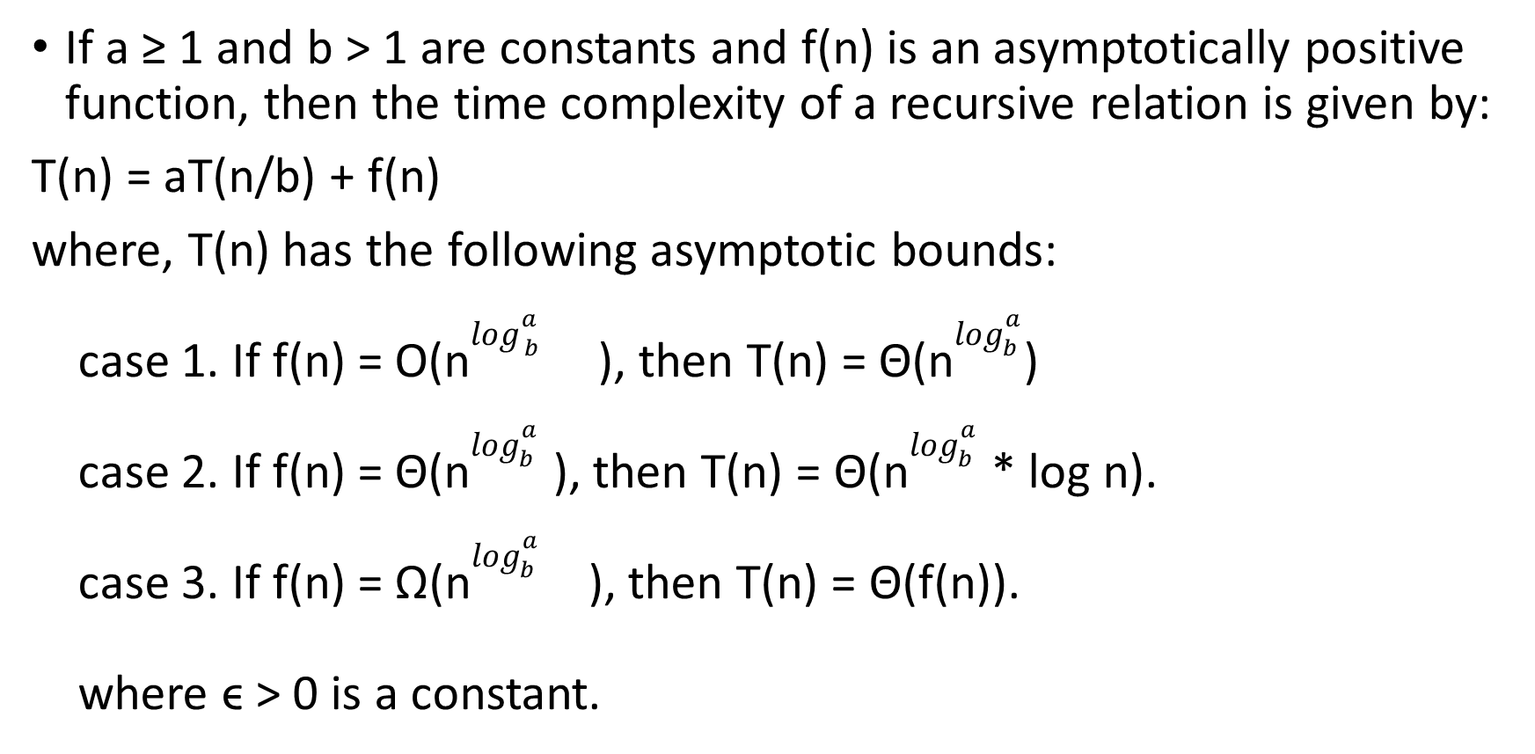
Master Theorem
If a ≥ 1 and b > 1 are constants and f(n) is an asymptotically positive function, then the time complexity of a recursive relation is given by:
T(n) = aT(n/b) + f(n)
where, T(n) has the following asymptotic bounds:
case 1. If f(n) = O(n$\log_{ b }^{a }$ ), then T(n) = Θ(n$\log_{b}^{a}$)
case 2. If f(n) = Θ(n$\log_{b}^{a}$ ), then T(n) = Θ(n$\log_{b}^{a}$ * log n).
case 3. If f(n) = Ω(n$\log_{b}^{a}$ ), then T(n) = Θ(f(n)).
where ϵ > 0 is a constant.
-ϵ
+ϵ

Slide 42
Example: Solve the recurrence T(n) = 3T(n/2) + n² using Master method.
Solution:
Here,
a = 3
n/b = n/2
f(n) = n²
log_{b} a = log₂ 3 ≈ 1.58 < 2
i.e. f(n) = n^{logb a+ϵ} , where, ϵ is a constant.
Case 3 implies here.
Thus, T(n) = Θ(n²)

Slide 43
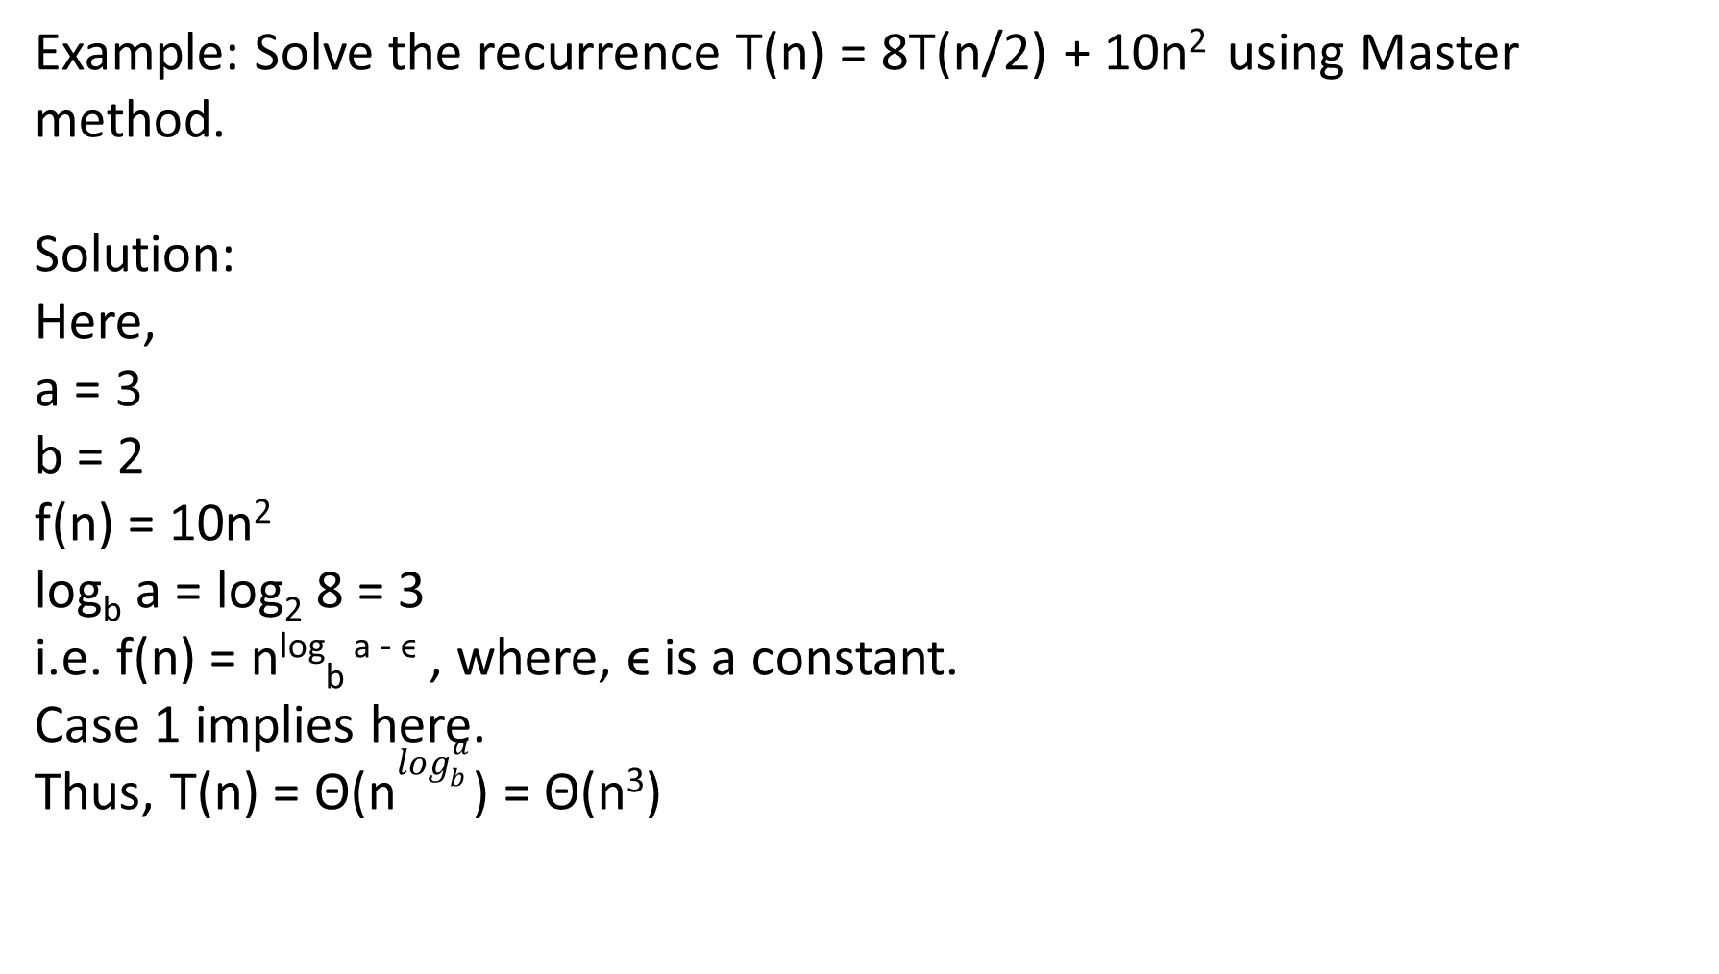
Example: Solve the recurrence T(n) = 8T(n/2) + 10n² using Master method.
Solution:
Here,
a = 3
b = 2
f(n) = 10n²
log_{b} a = log₂ 8 = 3
i.e. f(n) = n^{log}_{b} ^{a - ϵ} , where, ϵ is a constant.
Case 1 implies here.
Thus, T(n) = Θ(n$\log_{b}^{a}$) = Θ(n³)

Slide 44

Example: Solve the recurrence T(n) = 2T(n/2) + n using Master method.
Solution:
Here,
a = 2
b = 2
f(n) = n
log_{b} a = log₂ 2 = 1
i.e. f(n) = n^{log}_{b} ª
Case 2 implies here.
Thus, T(n) = Θ(n$\log_{b}^{a}$log n) = Θ(n log n)

Slide 45
Example: Solve the recurrence using Master method

Slide 46
Solution

